Slide 1
Greetings (Please Delete this Slide)
Thank you for submitting a Poster Presentation for the 2023 CRA & AHPA Annual Scientific Meeting
The following items will be uploaded as part of your poster submission:
Full graphic of your poster (PDF)
A 3-minute guided video recording of this PowerPoint presentation in MP4 format.
Click here to upload your PDF and 3 minute video and use the following naming convention: abstract number and presenting author name e.g. 2021-001-John Smith
Submission deadline is January 9, 2023.
Next steps: Please follow the instructions on slides 2, 3 and 4. Remember to delete slides 1-4. Thank you!

Slide 2
Instructions (Please Delete this Slide)
Slide 5
Insert your Poster Title, a Sub-Header (optional), and your name
Slide 6
Insert your entire Poster graphic
Slides 7-10
Crop and insert relevant sections of your Poster to slides

Slide 3
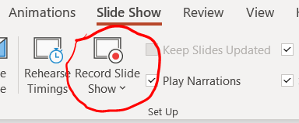
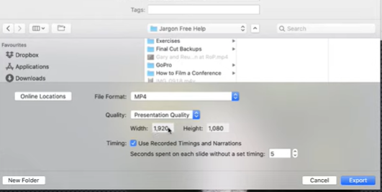
Recording on a Mac (Please Delete this Slide)
Step 1:
Select Slide Show from the menu, select Record Slide Show and click Record button. Click End Show when finished. Select Yes to save.
Ensure your microphone is turned on.
Step 2:
Select File from the menu, click on Export, select MP4 file format, select Presentation Quality, check Use Recorded timing and narrations and click on Export. Watch video tutorial

Slide 4
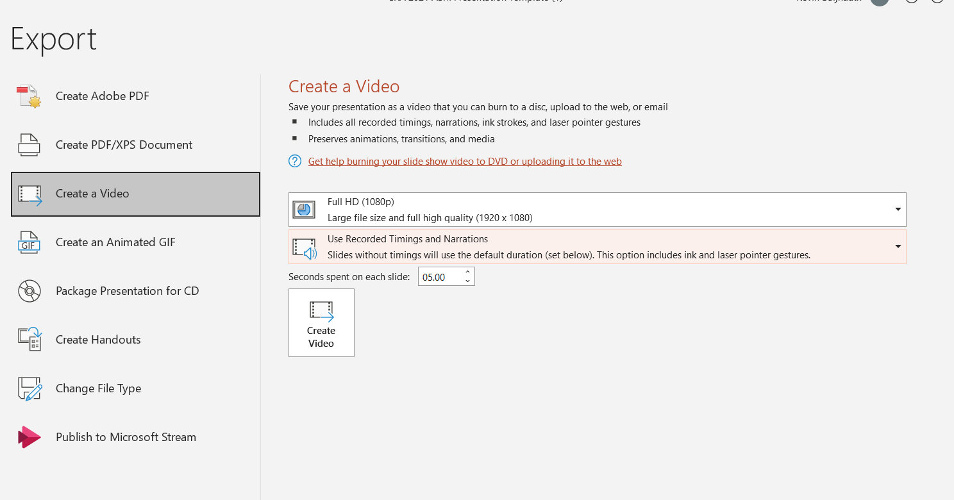
Recording on Windows (Please Delete this Slide)
Step 1:
Select Slide Show from the menu, and then select Record Slide Show and click Record button.
Ensure your microphone is turned on and then press record
Step 2:
Select File from the menu, click on Export, then select Create a Video
Click on Full HD and use the drop down to select your recording. Watch video tutorial

Slide 6
Poster Title
Sub-header
Poster Presenter

Slide 7
Poster

Slide 8
Background

Slide 9
Methods

Slide 10
Results

Slide 11
Conclusion

